Slide 1

Console I/O
An Introduction to Programming in Python
Notes:
Let's learn about Console Inputs and Outputs.

Slide 2
Phases of a Program
Input
Processing
Output
Notes:
Every program has three main phases:
The inputs are given to the program, processing occurs, and outputs are returned.
The Inputs and Outputs are how we connect programs to the real world.

Slide 3
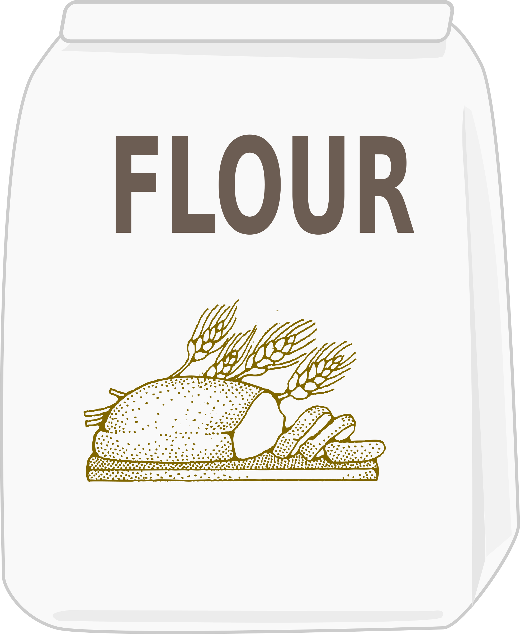


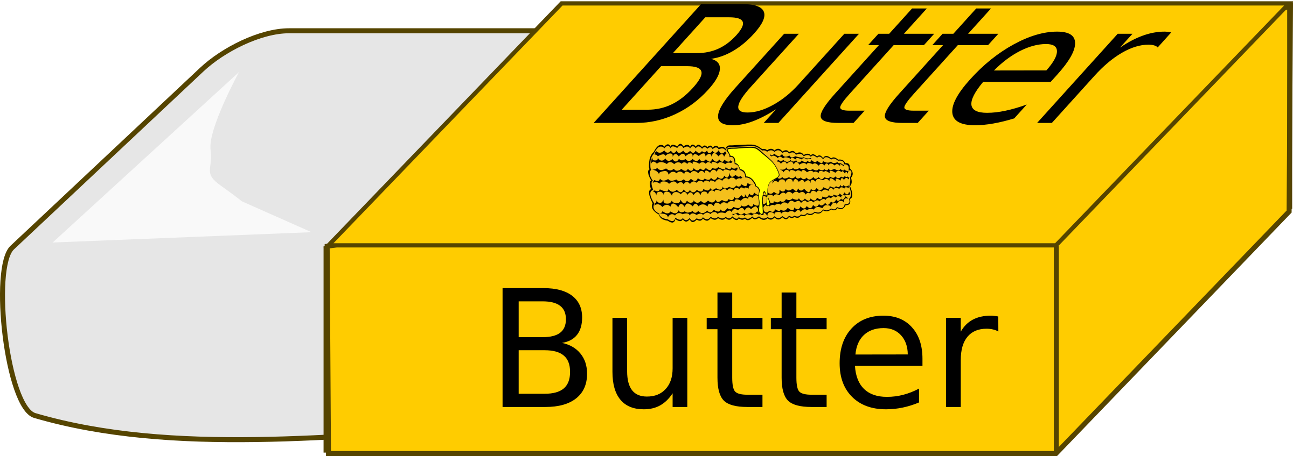
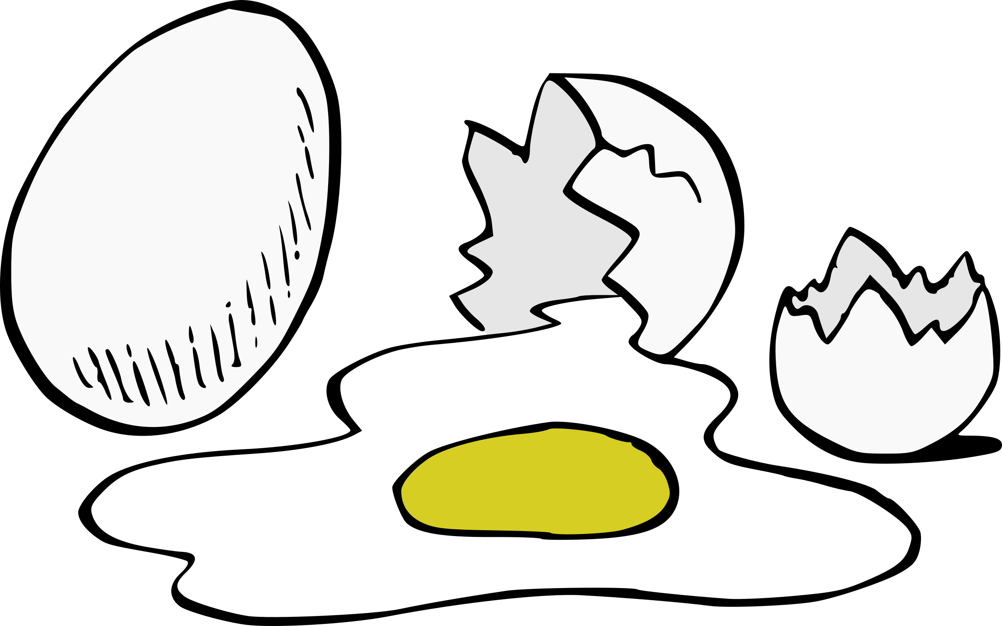
Programming is Like Baking
Inputs
Processing
Outputs
Notes:
Think of it like baking.
The inputs are your ingredients.
Mixing and stirring are the processing.
Then the cake is your output.

Slide 4

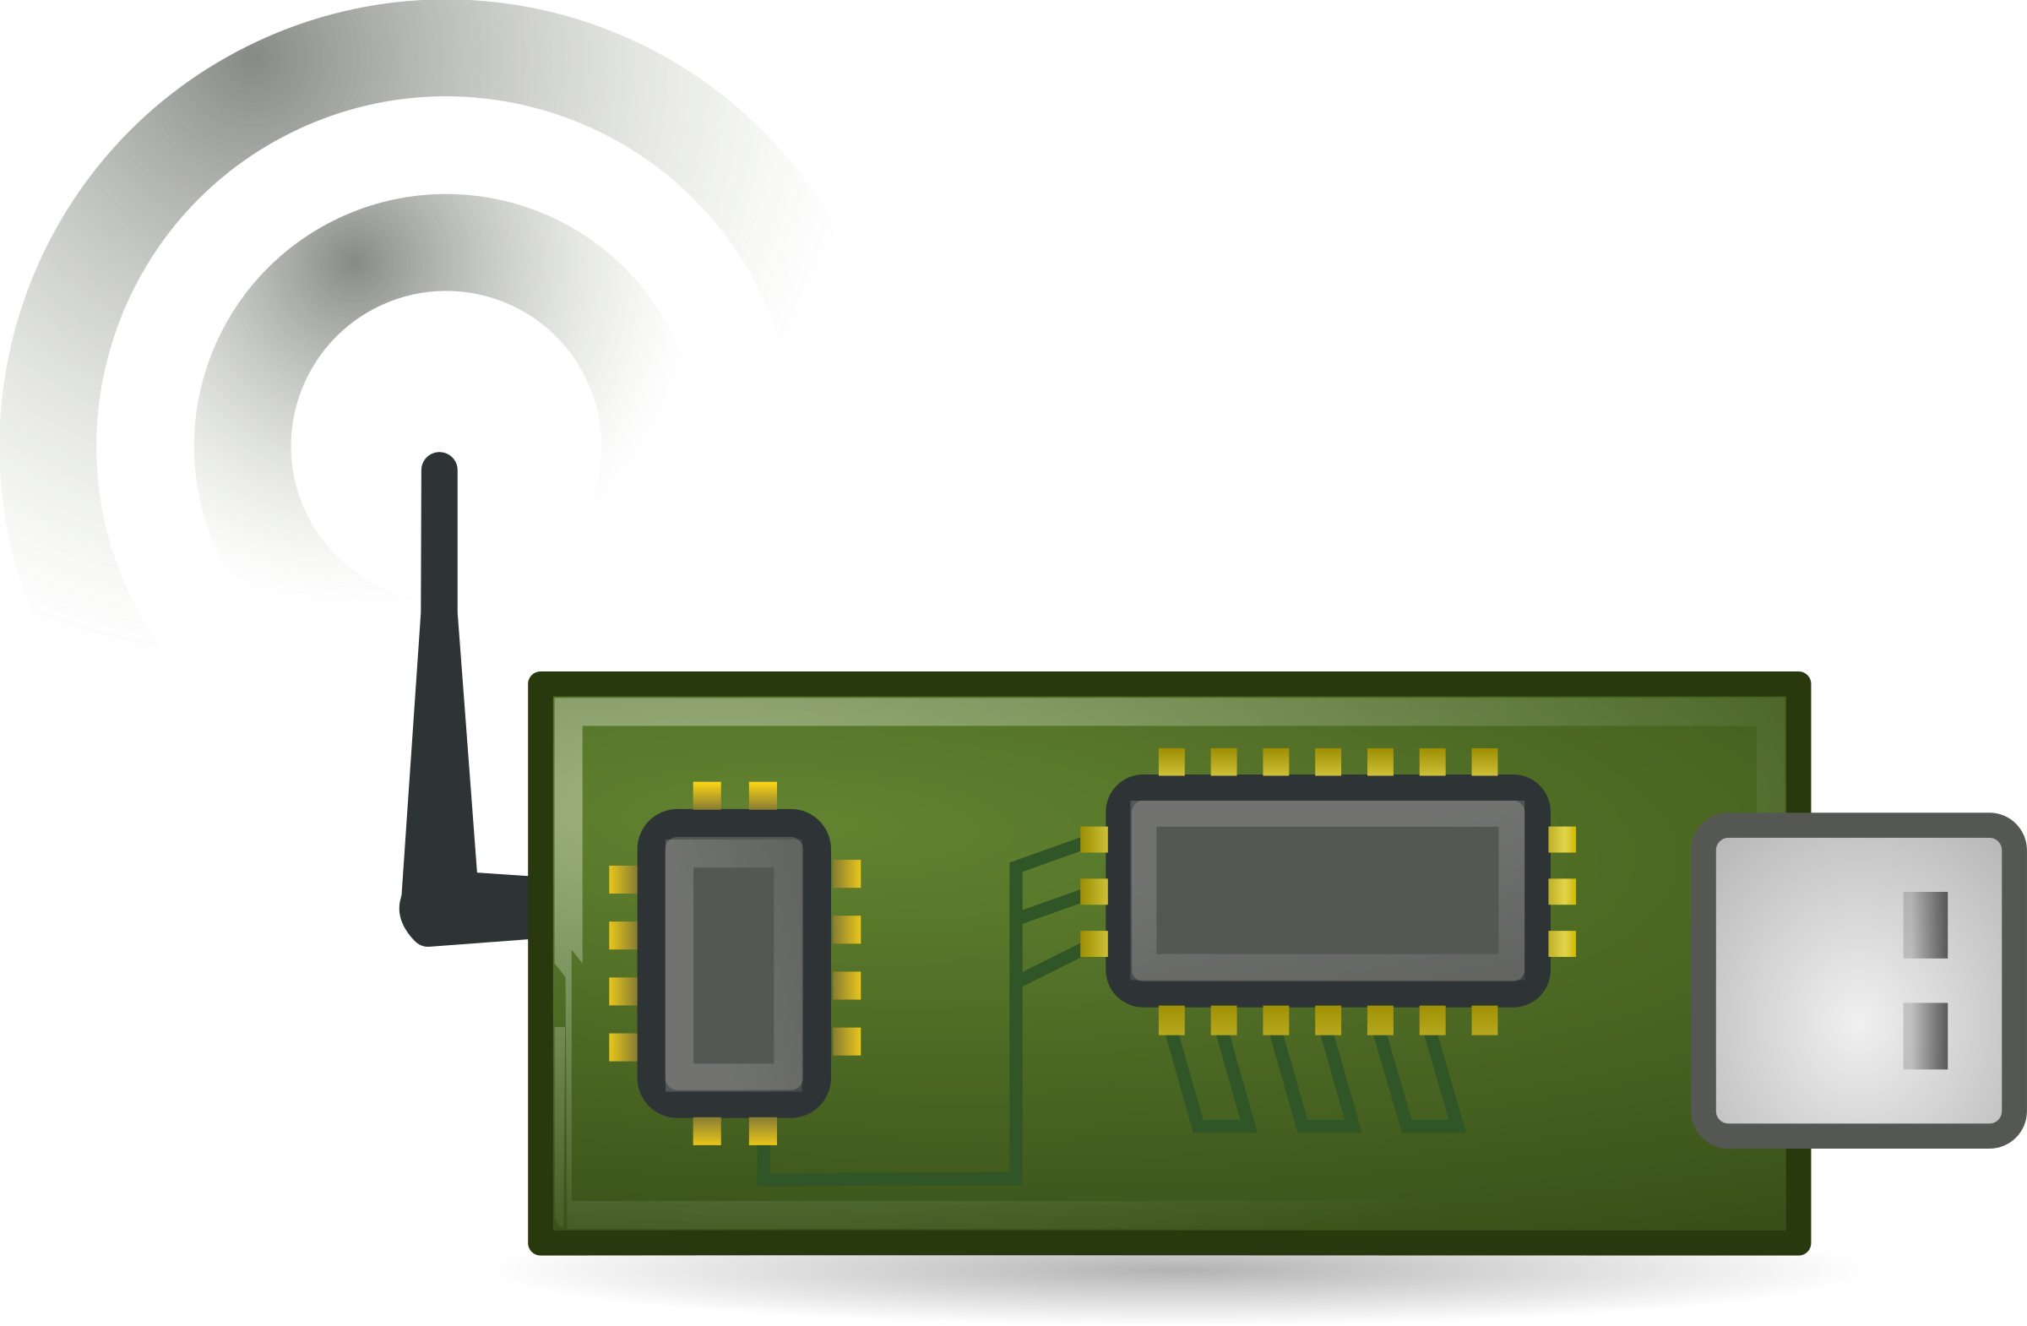
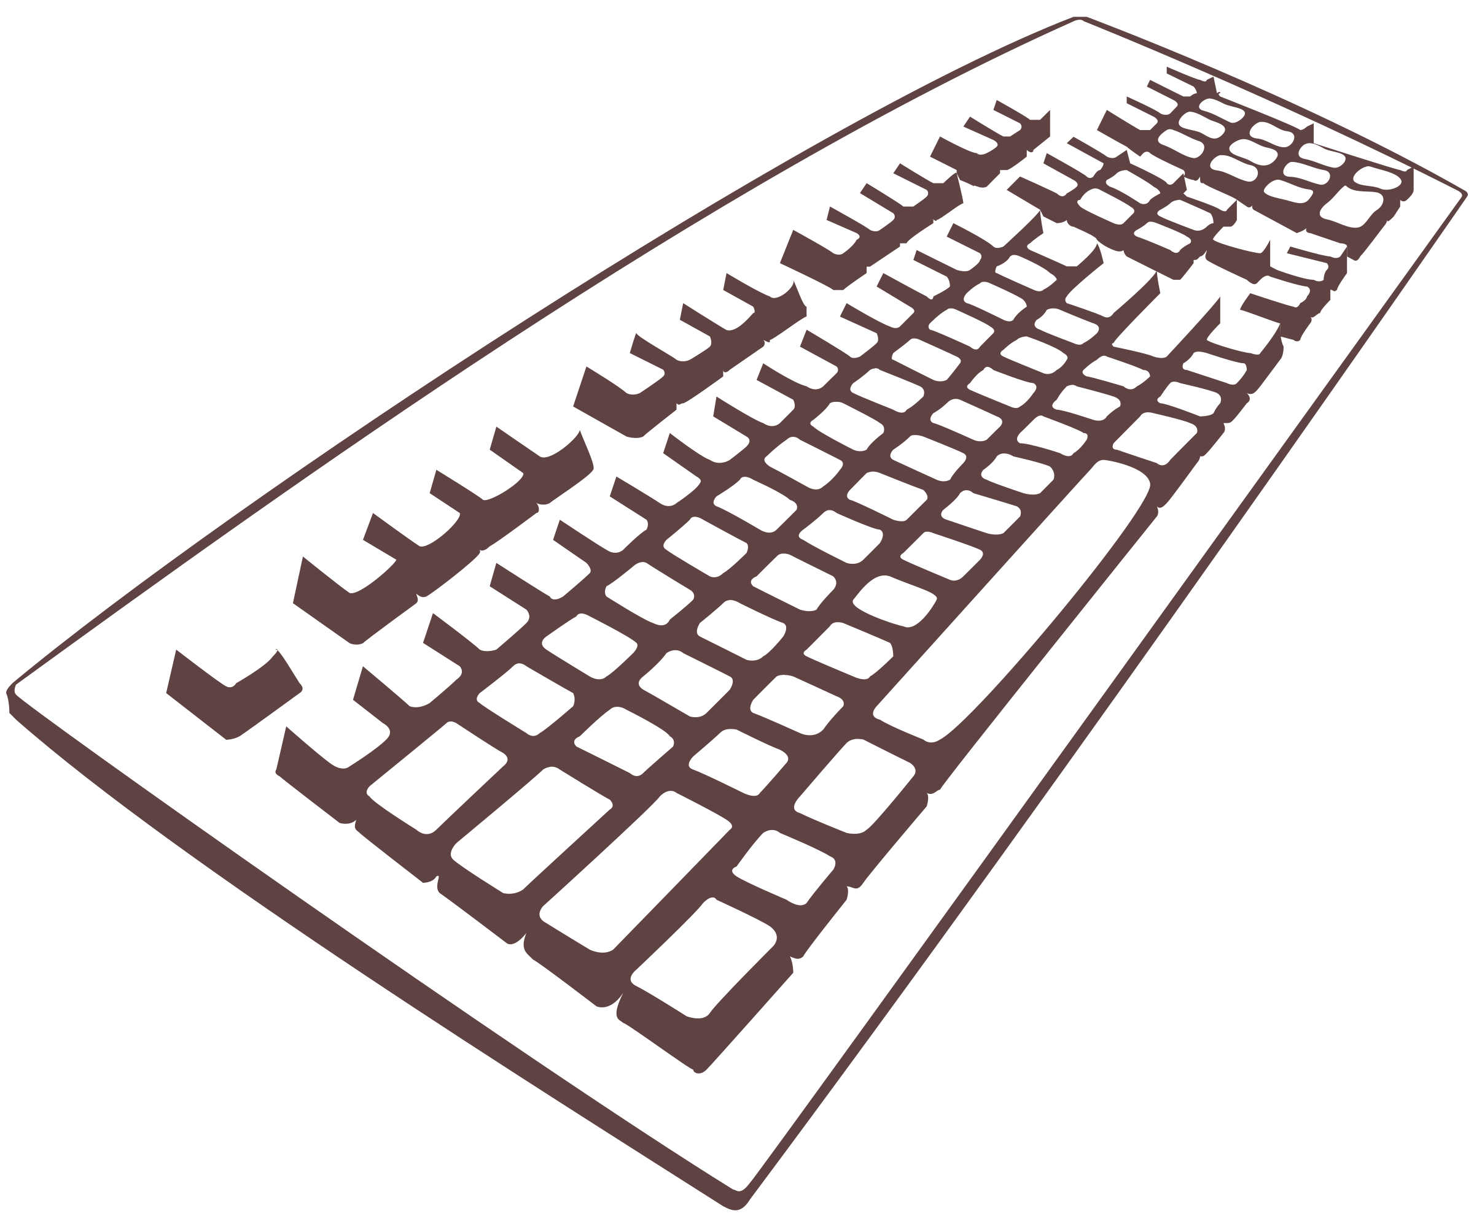
Inputs
Notes:
Examples of input are data typed by a keyboard, movements made by your mouse, data from the internet, and data from sensors.

Slide 5

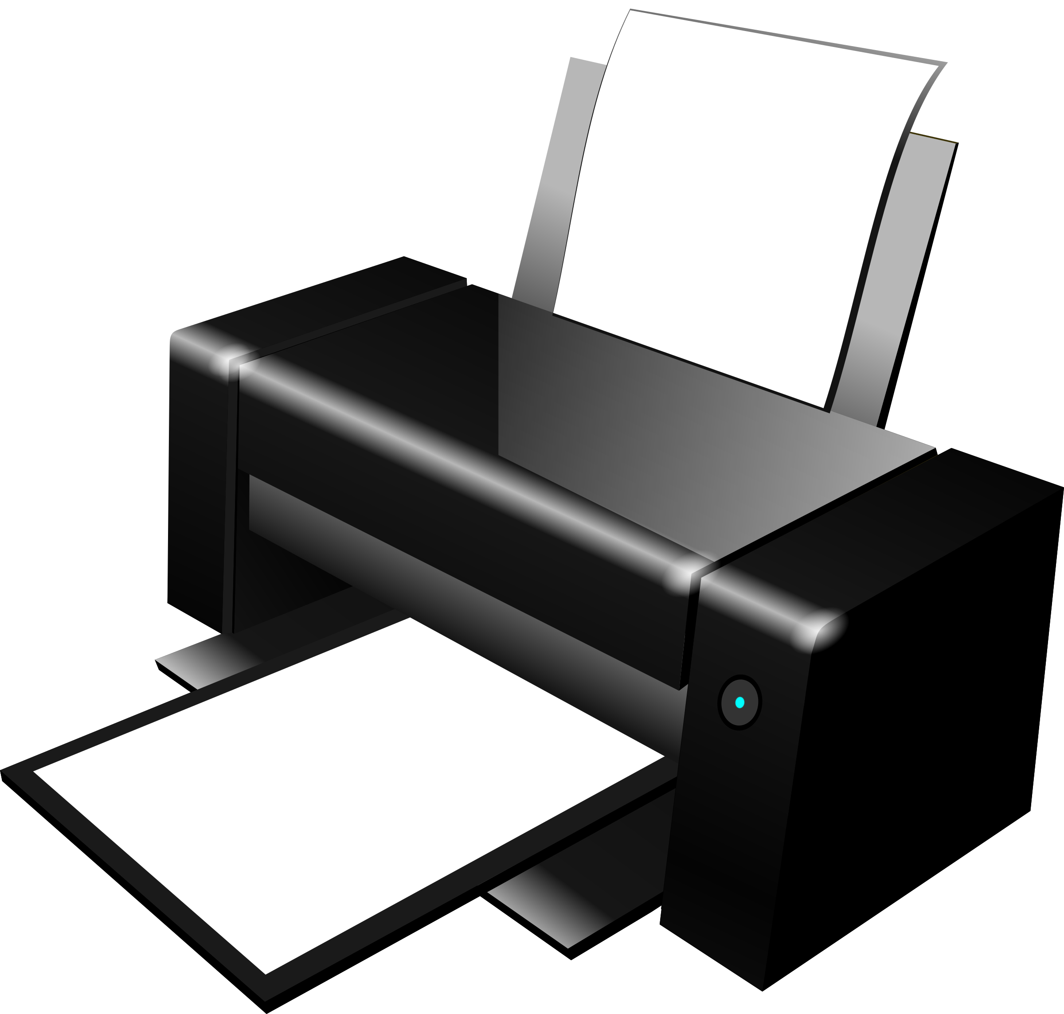

Outputs
Notes:
Examples of output are pixels on your screen, paper out of your printer, or the movement of a robotic arm.

Slide 6
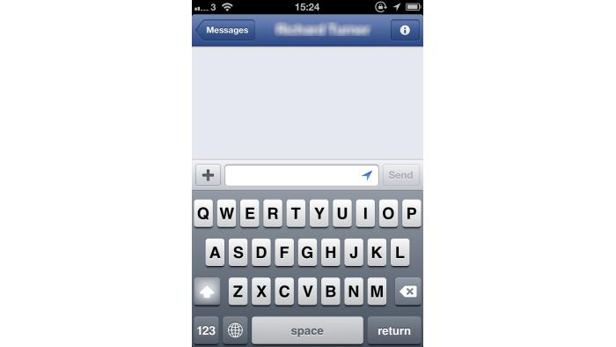
Console
Computer, do the thing
Yes sir, I've done the thing.
Great work, computer
Thanks, human.
Notes:
Computers take in data from users and put out results.
One of the most common ways to do this is the console.
You can think of the console as like a messenger box, for giving instructions to the computer.

Slide 7
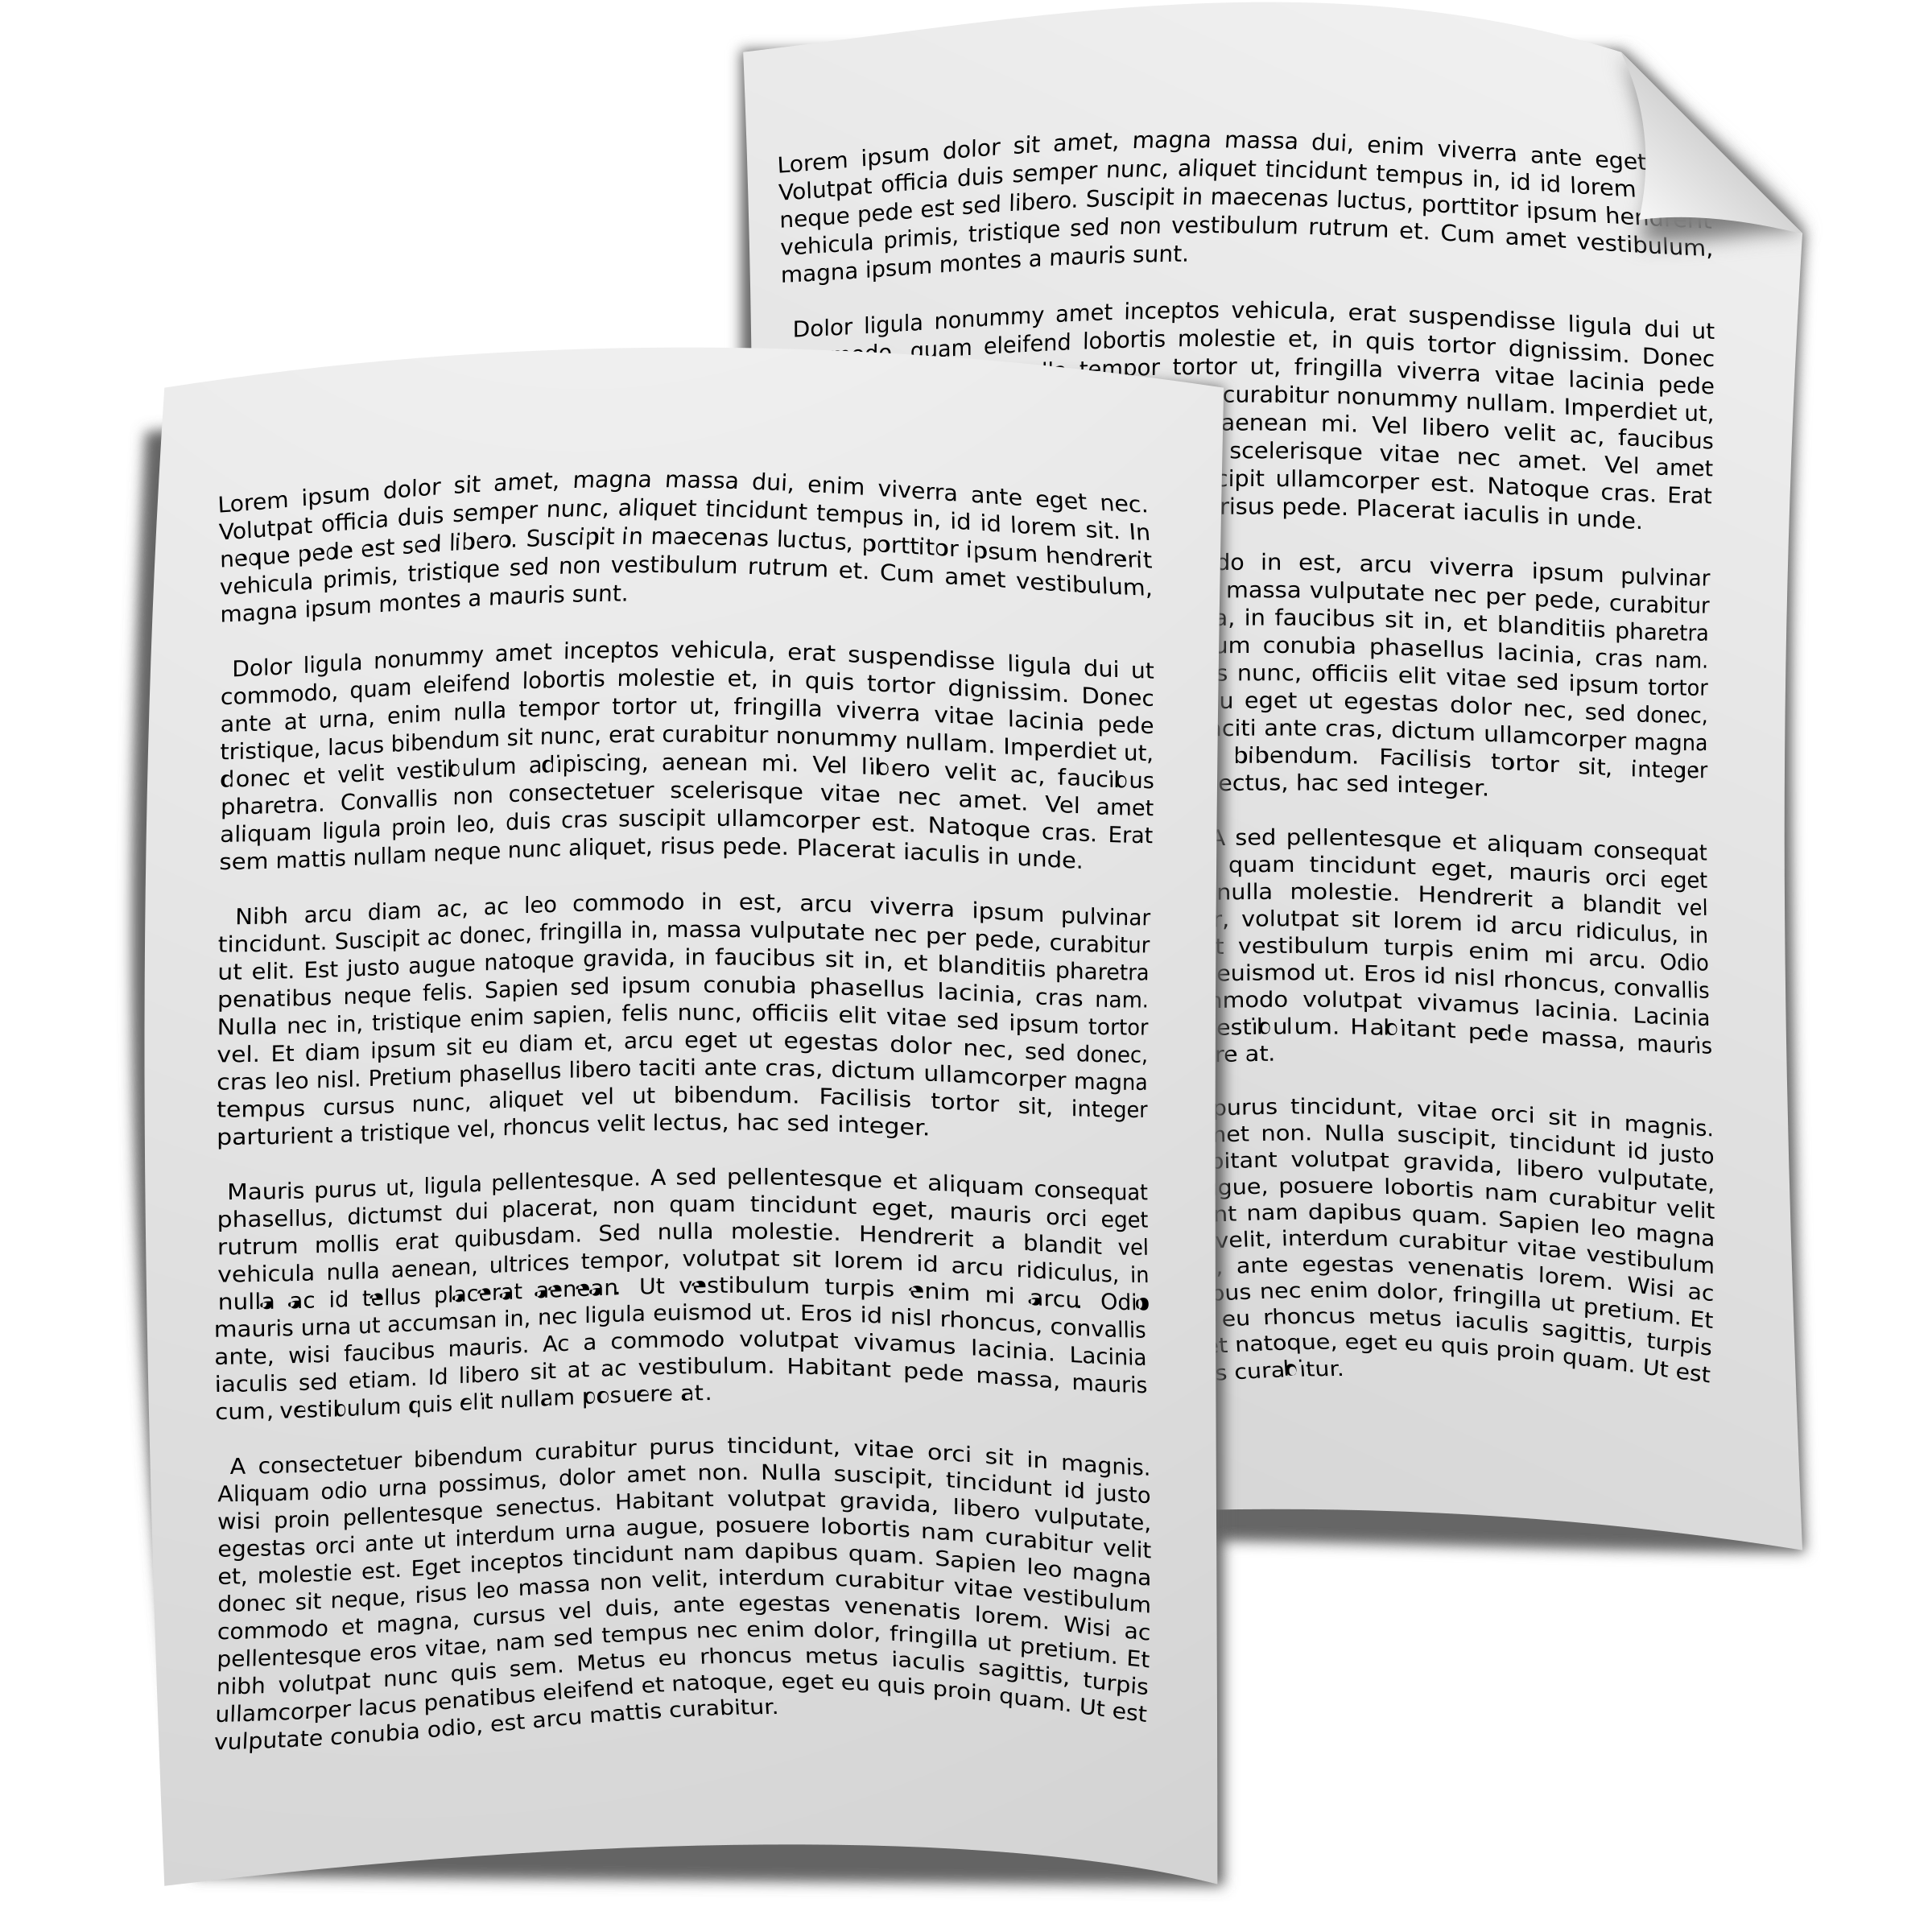
Code
print
input
Notes:
The instructions that we write are often stored in a program, so that they can be reused.
This is what "programs" or "code" really is.
Now let's learn how to write a very simple program by learning two kinds of commands: "Print" and "Input".
We will see these two commands as regular Python text, but also as BlockPy blocks.

Slide 8
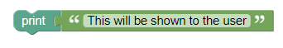
Print
Only the text INSIDE the quotation marks will be printed!
print("This will be shown to the user")
Notes:
The "print" function lets you write information to users.
Printing is necessary because we cannot see "inside" the mind of the computer, except what it writes on the console.
Notice that there is some text between the parentheses: this is the text that is output to the user.

Slide 9
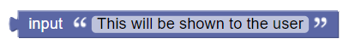
Input
input("This will be shown to the user")
Notes:
The "input" function lets you get information from users.
Notice that there is some text between the parentheses: this is the text that is shown as a prompt to the user.
Once the prompt is shown, the user can type their answer and press enter.

Slide 10
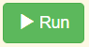
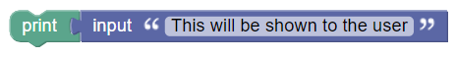
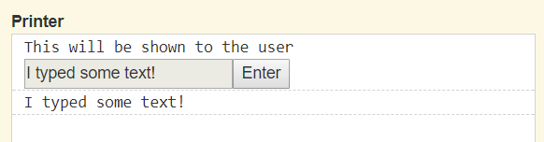
A Simple Program
print(input("This will be shown to the user"))
Notes:
Notice how we can combine these two commands by snapping them together.
This simple program will take some text from the user and then print it out.
The print statement does not print the word "input" - it prints out what the user typed in the box.
While not a very exciting program, it is a great example of the input/output mechanism of programs.

Slide 11
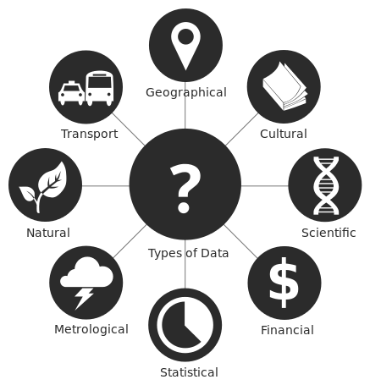
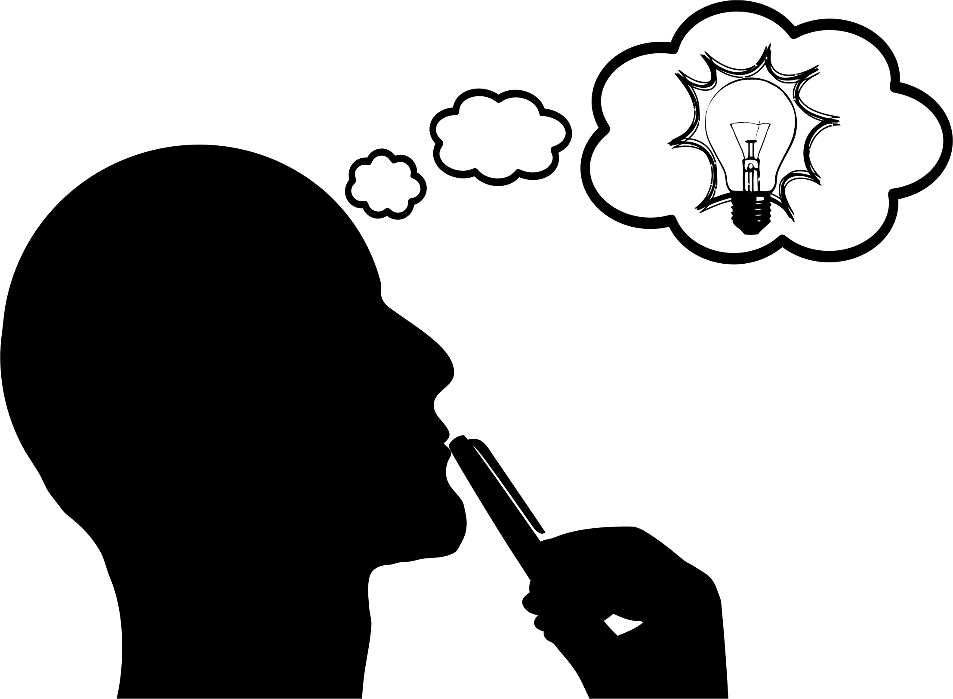
But Why?
PYTHON
"File:Data types - en.svg." Wikimedia Commons, the free media repository. 8 Jul 2017, 18:52 UTC.7 Aug 2017, 04:42
<https://commons.wikimedia.org/w/index.php?title=File:Data_types_-_en.svg&oldid=250696408>.
Notes:
The goal of any program is to transform the inputted data into the desired outputs.
For now, our programs will have simple inputs and simple outputs.
But eventually, we will create complex code that can achieve great things.

